Slide 1

CISCO AICTE VIRTUAL INTERNSHIP PROGRAM 2022 [Course Code: - SIP 2911]
-PRATHEESH RAJ P L– URK21CS1064

Slide 2
CISCO NETWORKING ACADEMY
Cisco Systems, Inc., commonly known as Cisco, is an American-based multinational digital communications technology conglomerate corporation headquartered in San Jose, California. Cisco develops, manufactures, and sells networking hardware, software, telecommunications equipment and other high-technology services and products. Cisco specializes in specific tech markets, such as the Internet of Things (IoT), domain security, videoconferencing, and energy management with leading products including Webex, OpenDNS, Jabber, Duo Security, and Jasper. Cisco is one of the largest technology companies in the world ranking 74 on the Fortune 100 with over $51 billion in revenue and nearly 80,000 employees.

Slide 3
PYTHON PROGRAMMING
Python is a high-level, general-purpose programming language. Its design philosophy emphasizes code readability with the use of significant indentation. Python is dynamically-typed and garbage-collected. It supports multiple programming paradigms, including structured, object-oriented and functional programming.
Python was conceived in the late 1980s by Guido van Rossum at Centrum Wiskunde & Informatica (CWI) in the Netherlands as a successor to the ABC programming language, which was inspired by SETL, capable of exception handling and interfacing with the Amoeba operating system. Its implementation began in December 1989.

Slide 4
IPV4 Address
The IPv4 address is a 32-bit number that uniquely identifies a network interface on a machine. An IPv4 address is typically written in decimal digits, formatted as four 8-bit
IPv4 addresses are canonically represented in dot-decimal notation, which consists of four decimal numbers, each ranging from 0 to 255, separated by dots, e.g., 172.16.254.1
An IP address is an address used in order to uniquely identify a device on an IP network. The address is made up of 32 binary bits, which can be divisible into a network portion and host portion with the help of a subnet mask. The 32 binary bits are broken into four octets (1 octet = 8 bits). Each octet is converted to decimal and separated by a period (dot). For this reason, an IP address is said to be expressed in dotted decimal format (for example, 172.16.81.100). The value in each octet ranges from 0 to 255 decimal, or 00000000 - 11111111 binary.

Slide 5
How to check if IPv4 is valid?
A valid IP address must be in the form of A.B.C.D, where A, B, C, and D are numbers from 0-255. The numbers cannot be 0 prefixed unless they are 0.

Slide 6
OBJECTIVE Problem Statement:
Task 1: Ask the user to input 10 ipv4 addresses.
Task 2: Check if the addresses are valid ipv4 addresses.
Task 3: Convert the ipv4 addresses which are in decimal format to Binary, Octal and Hexadecimal format For conversion use functions (inbuilt or library)
Task 4:Create a list which will hold the addresses. [Decimal, Binary, Octal and Hexadecimal]
Task 5: Transfer the contents of the list to a file named conversion.txt
Task 6: Print the following output on the screen (O/P OF TASK 4)

Slide 7
Algorithm
STEP1: CREATE A CLASS AND DEFINE A FUNCTION
STEP2: IN THAT FUNCTION CONDITIONAL STATEMENTS CHECK WHETHER IT IS A VALID IPV4 ADDRESS OR NOT
STEP3: IN MAIN USING LOOP STATEMENTS GET 10 IPV4 ADDRESS AS INPUT
STEP4: USING LOOP CONVERT THE IPV4 ADDRESS IN REQUIRED CONVERSION
STEP5: USING FILE HANDLING CONCEPT TRANSFER THE DATA TO A TEXT FILE

Slide 8
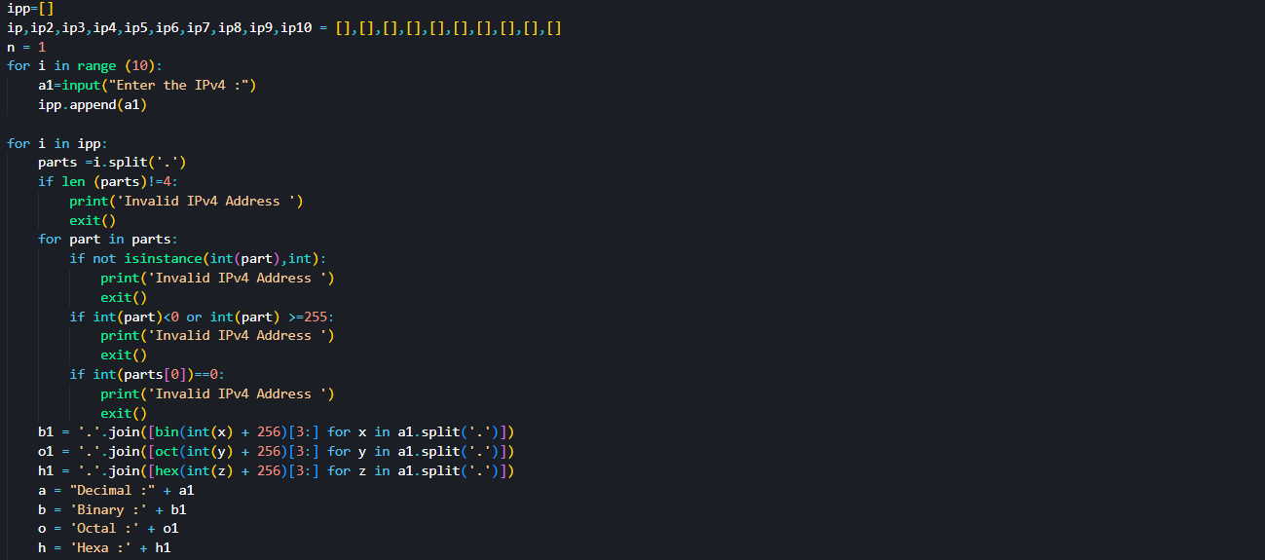
Source Code

Slide 9
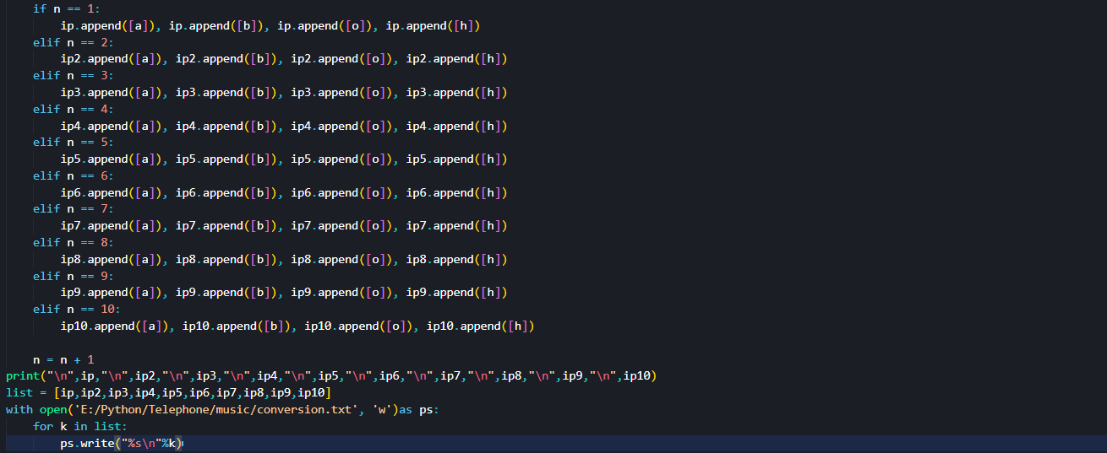
Source Code

Slide 10
Output:
['IPv4 Address’, 'Decimal’, 'Binary’, 'Octal’, 'Hexa-Decimal']
['127.132.32.44', '127.132.32.44', '01111111.10000100.00100000.00101100', '0177.0204.0040.0054', '7F84202C']
['1.1.1.1', '1.1.1.1', '00000001.00000001.00000001.00000001', '0001.0001.0001.0001', '01010101']
['255.255.255.255', '255.255.255.255', '11111111.11111111.11111111.11111111', '0377.0377.0377.0377', 'FFFFFFFF']
['1.0.0.1', '1.0.0.1', '00000001.00000000.00000000.00000001', '0001.0000.0000.0001', '01000001']
['16.12.32.112', '16.12.32.112', '00010000.00001100.00100000.01110000', '0020.0014.0040.0160', '100C2070']
['114.21.0.8', '114.21.0.8', '01110010.00010101.00000000.00001000', '0162.0025.0000.0010', '72150008']
['132.132.81.81', '132.132.81.81', '10000100.10000100.01010001.01010001', '0204.0204.0121.0121', '84845151']
['1.1.1.0', '1.1.1.0', '00000001.00000001.00000001.00000000', '0001.0001.0001.0000', '01010100']
['23.54.54.1', '23.54.54.1', '00010111.00110110.00110110.00000001', '0027.0066.0066.0001', '17363601']
['196.24.5.1', '196.24.5.1', '11000100.00011000.00000101.00000001', '0304.0030.0005.0001', 'C4180501']

Slide 11


